Slide 1

PROBABILITY & STATISTICS

Slide 2
THE NATURE OF PROBABILITY & STATISTICS

Slide 3
Books Recommended
Course Book
Elementary Statistics by BLUMAN (8th Ed)
Reference Book
Introduction to Staistical Theory (part-1) by
Sher Muhammad Chaudhry

Slide 4
STATISTICS
It is the science of conducting studies to collect, organize, summarize, analyze, and draw conclusions from data.

Slide 5
Two Major Areas of Statistics
Descriptive statistics consists of the collection, organization, summarization, and presentation of data.
Inferential statistics consists of generalizing from samples to population, performing estimation and hypothesis tests, determining relationships among variables and making predictions.

Slide 6
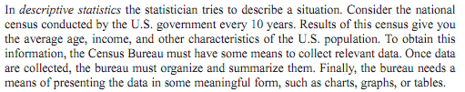

Slide 7

Inferential Statistics

Slide 8
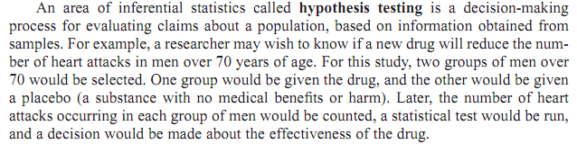
Hypothesis Testing

Slide 9
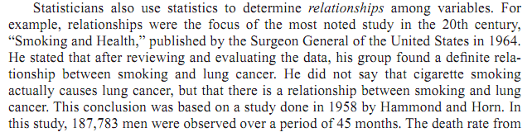
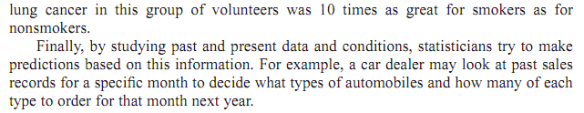
Relationships & Predictions

Slide 10
Statistical terms
A variable is a characteristic or attribute that can assume different values.
Data are the values (measurements or observations) that the variable can assume. Each value in the data set is called a datum.
A population consists of all subjects (human or otherwise) that are being studied.
A sample is a group of subjects selected from a population.

Slide 11
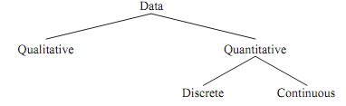
Classification of Variables

Slide 12
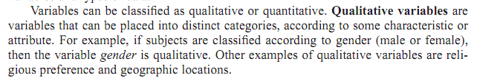
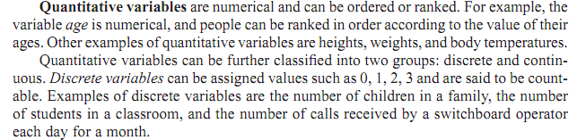
Types of Variables

Slide 13
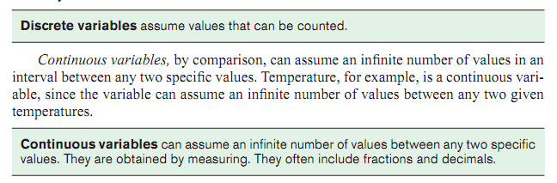

Slide 14
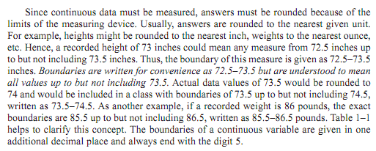
Continuous Data

Slide 15
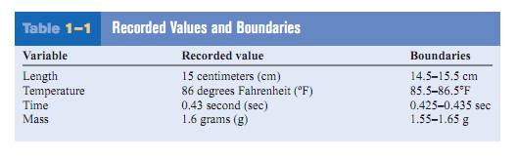
Examples

Slide 16
Measurement Scales
How variables are categorized, counted or measured.
Four common types of scales are:
Nominal
Ordinal
Interval
Ratio

Slide 17




Some Important Definitions

Slide 18
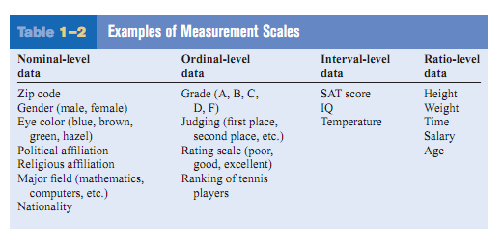
Examples

Slide 19
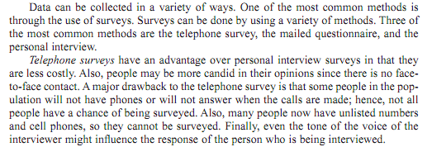
Data Collection

Slide 20

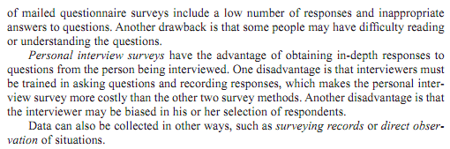

Slide 21

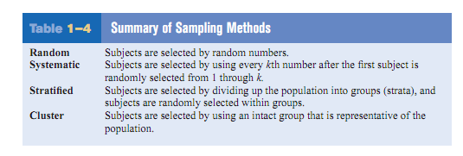
Sampling Techniques

Slide 22
Example 1
Identify each of the following as examples of
(1) Attribute (2) Discrete or (3) Continuous variables.
The hair color of children
The weight of a college student
The number of petals on a flower
Temperature recorded every half hour at a weather bureau.
the number of heads in the toss of 3 coins.
Marital status of a faculty member.
Lifetime of car batteries

Slide 23
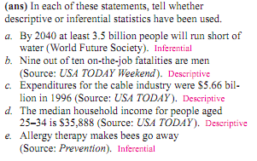
Example 2

Slide 24
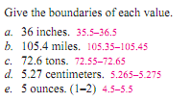
Example 3

Slide 25
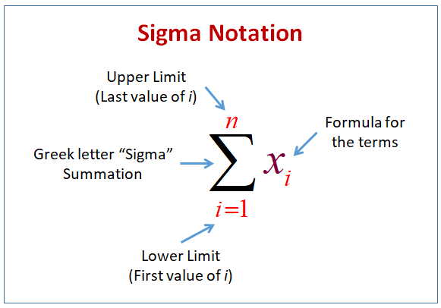
Sigma Notation

Slide 26
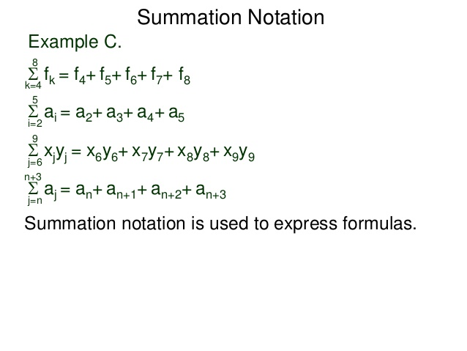
Example 4

Slide 27
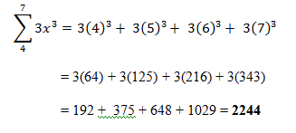
Example 5

